Slide 1
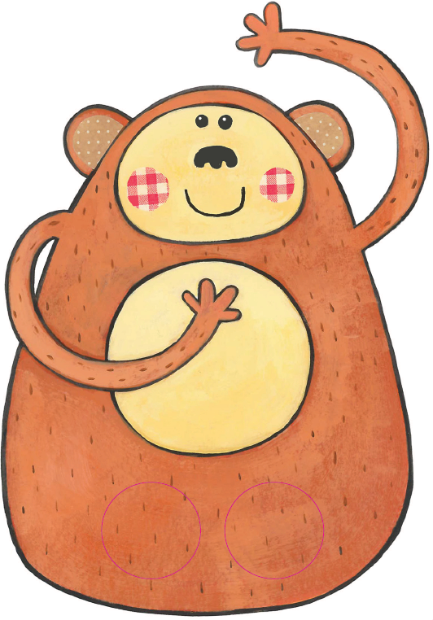

Seo Kiki.
’S e muncaidh beag
a th’ ann.
Notes:
Here’s Kiki.
He’s a little monkey.

Slide 2
Bidh e a’ leum ’s a’ streap.
Notes:
He jumps and he climbs.

Slide 3
Dà mhuncaidh bheag a’ leum air an leabaidh
Dà mhuncaidh bheag a’ leum air an leabaidh
Notes:
Two little monkeys jumping on the bed. X2

Slide 4
Thuit aon mhuncaidh beag
’s ghoirtich e a chasan
Notes:
One little monkey fell and hurt his legs.

Slide 5
Aon mhuncaidh beag a’ leum air an leabaidh
Notes:
Two little monkeys jumping on the bed. X2

Slide 6
Aon mhuncaidh beag a’ leum air an leabaidh
Aon mhuncaidh beag a’ leum air an leabaidh
Notes:
Two little monkeys jumping on the bed. X2

Slide 7
Thuit aon mhuncaidh beag
Chaidh e às an t-sealladh
Notes:
One little monkey fell.
He went out of sight.

Slide 8
Chan eil muncaidh idir
A’ leum air an leabaidh
Notes:
No moneys at all are jumping on the bed.

